Slide 1

Traversal Brief
Shivansh Srivastav

Slide 2
Agenda
Setup
Starting point & Phases
Traversal Logic
Skill Relationship & Backtracking
Primary goals
Presentation Title

Slide 3
DESIGN
Initial Assessment
Traversal
Self-assessment Questionnaire 2 mins
Inter-skill and Intra-skill movement, Difficulty adjustment
Setup
Interview Length, Skills, Experience range, Question time
Time Allocation
Starting Point
2 mins for Initial assessment, 26 main minutes, 2 mins for wrap-up
Skill with most experience at an intermediate level

Slide 4
Throughout Phases
Question Selection Logic
Backtracking
Main Interview Loop
Skill Transition Logic
Experience Level Adaption
Time Management
Final Assessment
Main Interview Loop Integration
Performance Assessment
Skill Transition Logic
Skill Relationship Matrix
Coverage & Performance Tracker
Transition Decision Funcn
Next-Skill Selection
Complete

Slide 5
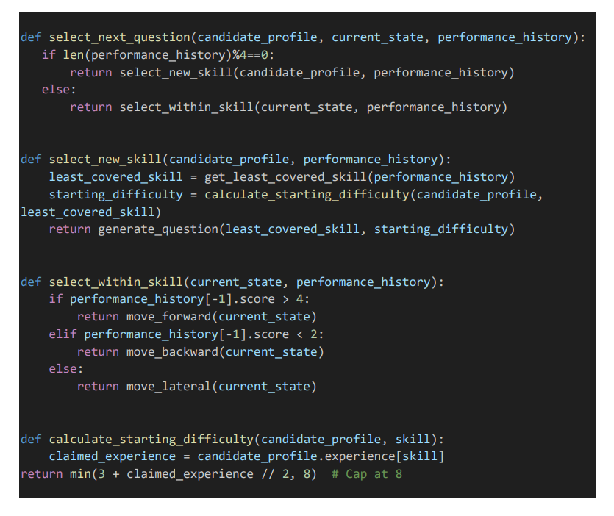
1. Question Selection Logic
It takes three parameters:
candidate_profile: Contains information about the candidate, including their claimed experience in different skills.
current_state: Represents the current state of the interview, including the current skill and difficulty level.
performance_history: A list of the candidate's performances on previous questions.
It checks the score of the last question in performance_history:
If the score is greater than 4 (good performance), it calls move_forward(current_state) to increase difficulty.
If the score is less than 2 (poor performance), it calls move_backward(current_state) to decrease difficulty.
Otherwise (average performance), it calls move_lateral(current_state) to maintain the current difficulty level.
Starting difficulty is calculated as (3 + claimed_experience // 2):
The base difficulty is 3, ensuring even candidates with no experience start at a moderate level.
Half the years of experience (integer division by 2) is added to this base.
For example, someone with 6 years of experience would start at difficulty 3 + (6 // 2) = 6.

Slide 6
7. Backtracking
The benefits of this backtracking approach include:
Adaptability: If a candidate struggles with a particular topic, the interview can move back to easier questions or a different skill.
Comprehensive assessment: It allows the system to revisit areas where the candidate might need more assessment, ensuring a thorough evaluation.
Flexible navigation: The interview can dynamically adjust its path based on the candidate's performance, creating a more personalized experience.
Robustness: If the system accidentally moves to a topic that's too advanced for the candidate, it can easily step back.
8. Main Interview Loop
Key aspects of this main loop:
Time Management: The loop runs for a fixed duration, ensuring the interview doesn't overrun.
Adaptive Questioning: It continuously selects questions based on the candidate's profile and ongoing performance.
Performance Tracking: It keeps a detailed record of the candidate's performance on each question.
Dynamic Difficulty Adjustment: Through backtracking and state updates, it adjusts the difficulty and focus areas
based on the candidate's responses.
Comprehensive Assessment: By running for a set time and collecting detailed performance data, it aims to
provide a thorough evaluation of the candidate's skills across multiple areas.

Slide 7
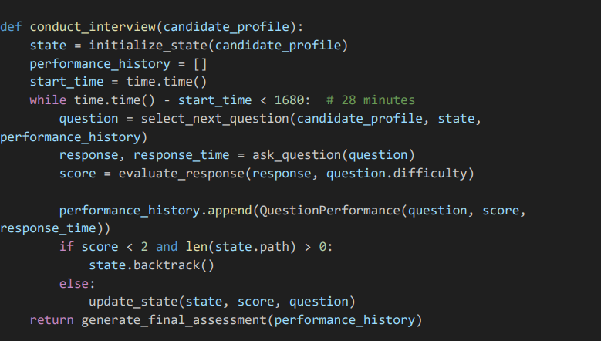
1. Main Interview Loop
Initialization:
state = initialize_state(candidate_profile): This sets up the initial state of the interview based on the candidate's profile. It likely includes setting the starting skill and difficulty level.
performance_history = []: This list will store the candidate's performance on each question.
start_time = time.time(): This captures the start time of the interview.
Question Selection: question = select_next_question(candidate_profile, state, performance_history) This selects the next question based on the candidate's profile, current state, and past performance.
Asking the Question: response, response_time = ask_question(question) This presents the question to the candidate and records their response and the time taken.
Evaluation: score = evaluate_response(response, question.difficulty) This evaluates the candidate's response and assigns a score.
Recording Performance: performance_history.append(QuestionPerformance(question, score, response_time)) This adds the question, score, and response time to the performance history.

Slide 8
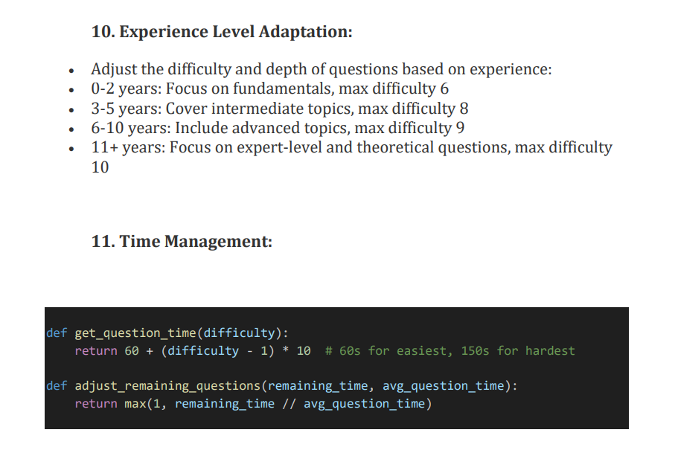
1. Experience level and Time management
60 sec for difficulty1 then
Add 10 sec for each (dif+1)

Slide 9
SKILL_RELATIONSHIPS = {
'Python': ['Data Analysis', 'Machine Learning’, 'Cloud'],
'Data Analysis': ['Python', 'Machine Learning', 'Deep Learning'],
'Machine Learning': ['Data Analysis', 'Deep Learning’, 'NLP'],
'Deep Learning': ['Machine Learning', 'NLP'],
'NLP': ['Machine Learning', 'Deep Learning'],
'Cloud': ['Python', 'Machine Learning']
}
# This matrix defines the relationships between different skills. Its used to ensure logical transitions between related skills.
skill_coverage = {skill: 0 for skill in SKILLS}
skill_performance = {skill: [] for skill in SKILLS}
# These dictionaries keep track of how much each skill has been covered and the candidate's performance in each skill.
This function decides whether it's time to transition to a new skill. It considers:
The candidate's recent performance in the current skill (last 3 questions)
How long they've been on the current skill
It suggests a transition if:
The candidate is performing very well if the
(avg_score > 4.5)
The candidate is struggling significantly if the (avg_score < 1.5)
They've spent a long time on the current skill (time_in_skill >= 4)
# Transition Decision Function:
def should_transition_skill(current_skill, performance_history, skill_coverage):
recent_questions = [q for q in performance_history[-3:] if q.skill == current_skill]
if len(recent_questions) < 3:
return False # Not enough questions in current skill to judge
avg_score = sum(q.score for q in recent_questions) / len(recent_questions)
time_in_skill = sum(skill_coverage.values()) - skill_coverage[current_skill]
return avg_score > 4.5 or avg_score < 1.5 or time_in_skill >= 4

Slide 10
2.5 Breaking down calculate_skill_performance:
return sum(q.score for q in skill_questions) / len(skill_questions) / 5
sum(q.score for q in skill_questions):
This uses a generator expression to sum up all the scores for questions in this skill.
For example, if there were three questions with scores 3, 4, and 5, this would sum to 12.
/ len(skill_questions):
This divides the sum by the number of questions, calculating the average score.
Continuing our example: 12 / 3 = 4
Why? (/ 5):
This is the normalization step. It's dividing the average by 5.
The reason for dividing by 5 is that the original scoring system use a scale of 0-5 (as evidenced by other parts of the code where scores > 4 are considered high and < 2 are considered low).
By dividing by 5, we're converting the 0-5 scale to a 0-1 scale.
In our example: 4 / 5 = 0.8

Slide 11
12. Final Assessment
Key aspects of this final assessment:
Comprehensive Evaluation: It considers the candidate's performance across all skills tested during the interview.
Skill-Specific Analysis: By calculating average scores for each skill, it provides a detailed breakdown of the candidate's abilities in different areas.
Strengths and Weaknesses: It clearly identifies areas where the candidate excels (strengths) and areas that need improvement (weaknesses).
Overall Score: The overall score gives a quick, high-level view of the candidate's performance across all skills.
Detailed Breakdown: The skill_breakdown provides granular information about performance in each skill, which can be useful for more in-depth analysis.
This final assessment provides a well-rounded view of the candidate's performance, balancing high-level summary information (overall score, strengths, weaknesses) with detailed, skill-specific data. This can be extremely valuable for making informed hiring decisions and providing constructive feedback to candidates.
The use of thresholds (> 4 for strengths, < 2 for weaknesses) allows for clear categorization of skills, though these thresholds could potentially be adjusted based on the specific needs or standards of the hiring organization.

Slide 12




Thank you
Shivansh Srivastav
NEURALNITI Pvt Ltd.

